Slide 1
Solutions and Solubility
PS-21 January 24, 2014

Slide 3
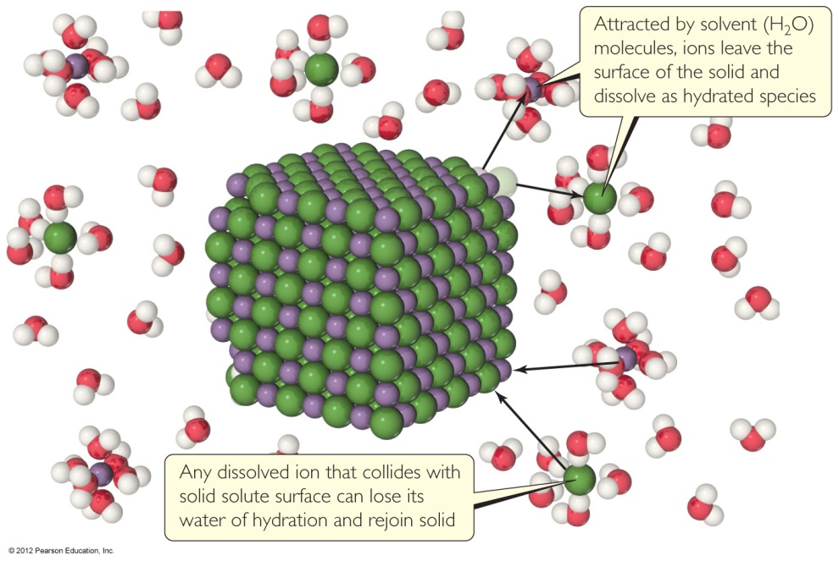
Solutions
Solutions are homogeneous mixtures of two or more pure substances.
In a solution, the solute is dispersed uniformly throughout the solvent.
© 2012 Pearson Education, Inc.

Slide 4
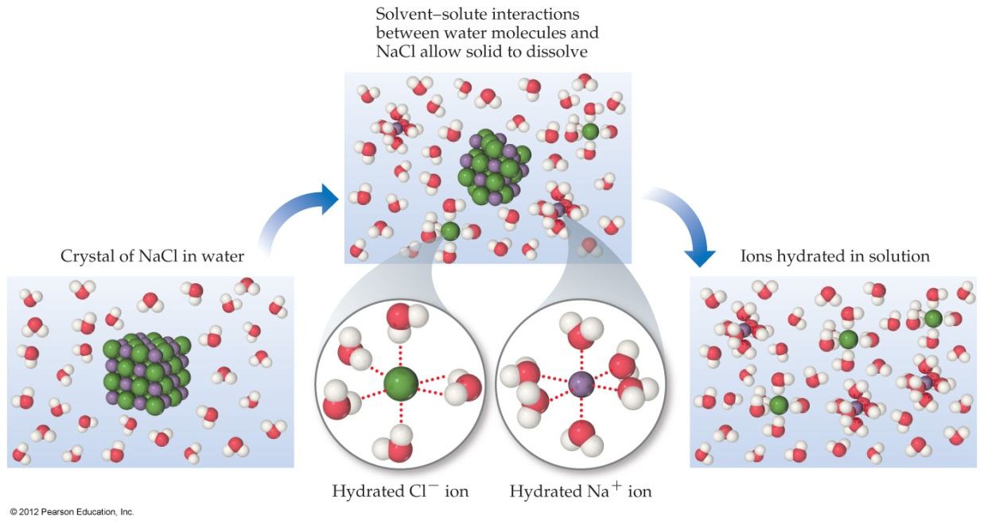
Solutions
The intermolecular forces between solute and solvent particles must be strong enough to compete with those between solute particles and those between solvent particles.
© 2012 Pearson Education, Inc.

Slide 5
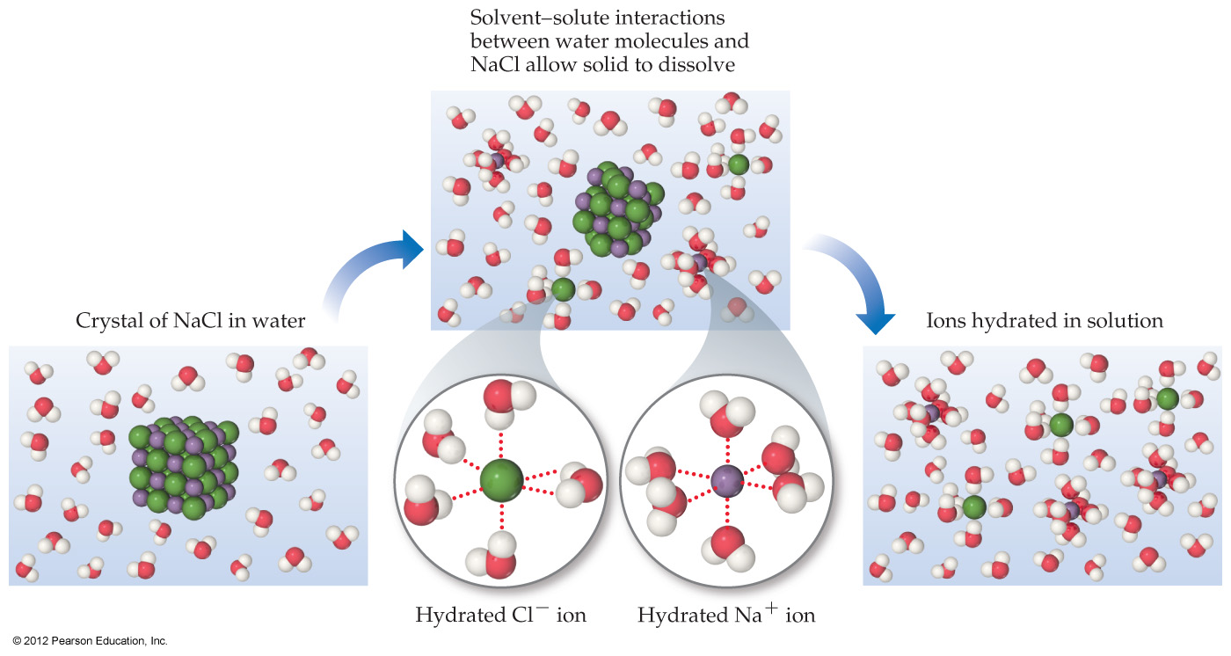
How Does a Solution Form?
As a solution forms, the solvent pulls solute particles apart and surrounds, or solvates, them.
© 2012 Pearson Education, Inc.

Slide 6
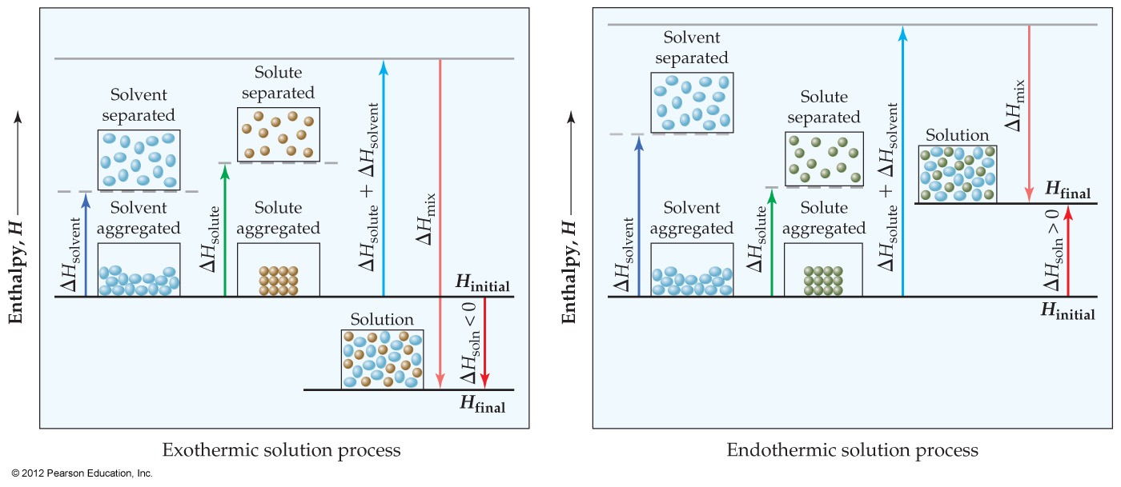
Energy Changes in Solution
Simply put, three processes affect the energetics of solution:
  Separation of solute particles,
  Separation of solvent particles,
  New interactions between solute and solvent.
© 2012 Pearson Education, Inc.

Slide 7
Energy Changes in Solution
The enthalpy change of the overall process depends on ΔH for each of these steps.
© 2012 Pearson Education, Inc.

Slide 8
Why Do Endothermic Processes Occur?
Yet we know that in some processes, like the dissolution of NH₄NO₃ in water, heat is absorbed, not released.
The reason is that increasing the disorder or randomness (known as entropy) of a system tends to lower the energy of the system.
© 2012 Pearson Education, Inc.

Slide 9
Enthalpy Is Only Part of the Picture
So even though enthalpy may increase, the overall energy of the system can still decrease if the system becomes more disordered.
© 2012 Pearson Education, Inc.

Slide 10
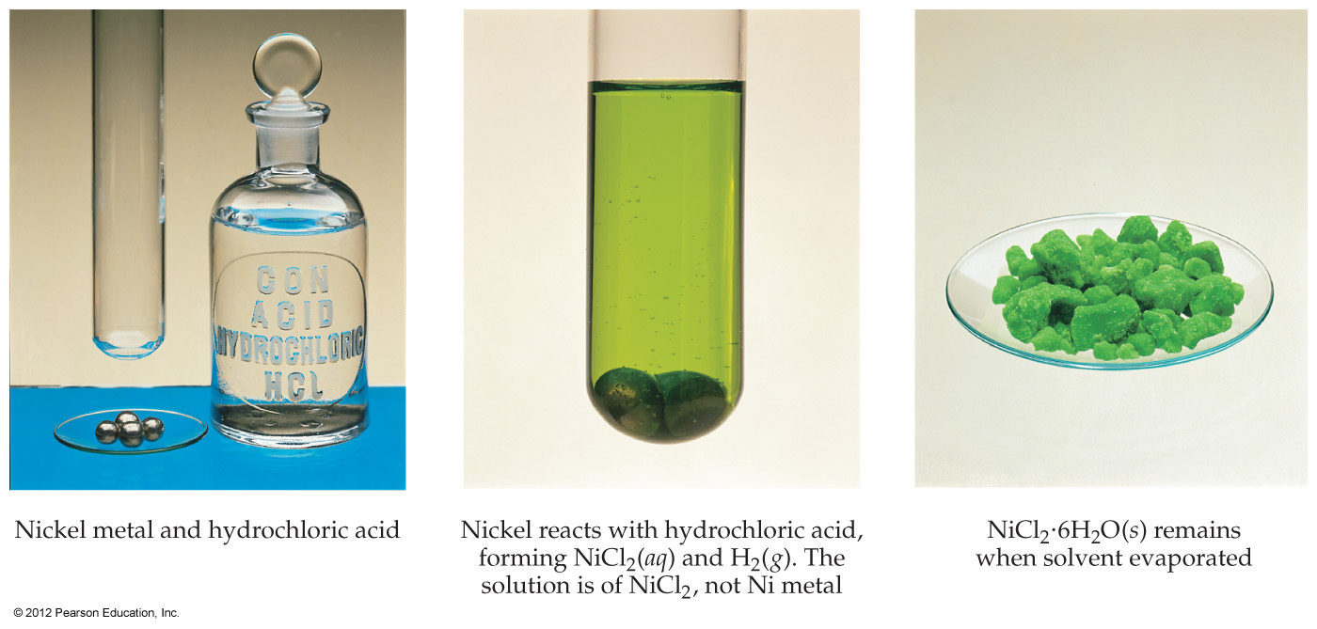
Student, Beware!
Just because a substance disappears when it comes in contact with a solvent, it doesn’t mean the substance dissolved. It may have reacted.
© 2012 Pearson Education, Inc.

Slide 11
Student, Beware!
Dissolution is a physical change—you can get back the original solute by evaporating the solvent.
If you can’t get it back, the substance didn’t dissolve, it reacted.
© 2012 Pearson Education, Inc.

Slide 12

Types of Solutions
Saturated
  In a saturated solution, the solvent holds as much solute as is possible at that temperature.
  Dissolved solute is in dynamic equilibrium with solid solute particles.
© 2012 Pearson Education, Inc.

Slide 13
Types of Solutions
Unsaturated
  If a solution is unsaturated, less solute than can dissolve in the solvent at that temperature is dissolved in the solvent.
© 2012 Pearson Education, Inc.

Slide 14
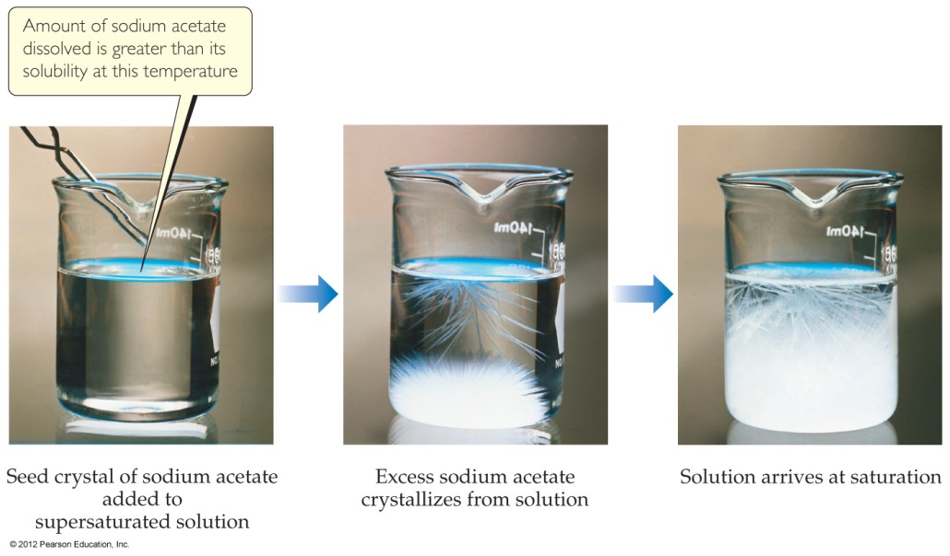
Types of Solutions
Supersaturated
  In supersaturated solutions, the solvent holds more solute than is normally possible at that temperature.
  These solutions are unstable; crystallization can usually be stimulated by adding a “seed crystal” or scratching the side of the flask.
© 2012 Pearson Education, Inc.

Slide 15
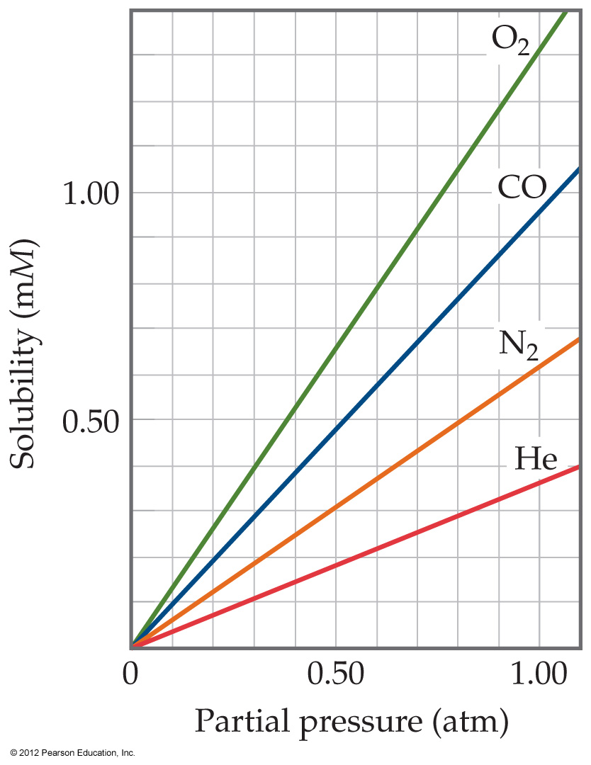
Gases in Solution
The solubility of liquids and solids does not change appreciably with pressure.
But the solubility of a gas in a liquid is directly proportional to its pressure.
© 2012 Pearson Education, Inc.
Notes:
Start here 1/21/10--8:30 & 10

Slide 16
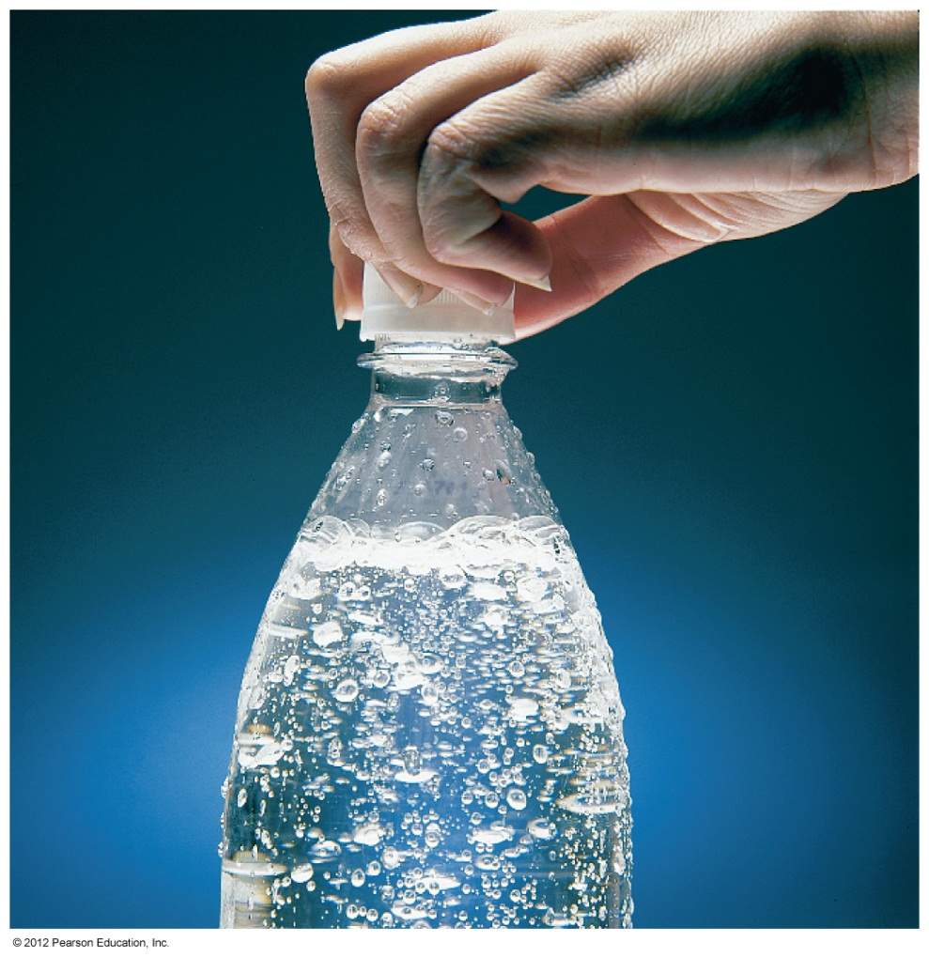
Henry’s Law
S_{g} = kP_{g}
where
S_{g} is the solubility of the gas,
k is the Henry’s Law constant for that gas in that solvent, and
P_{g} is the partial pressure of the gas above the liquid.
© 2012 Pearson Education, Inc.

Slide 17
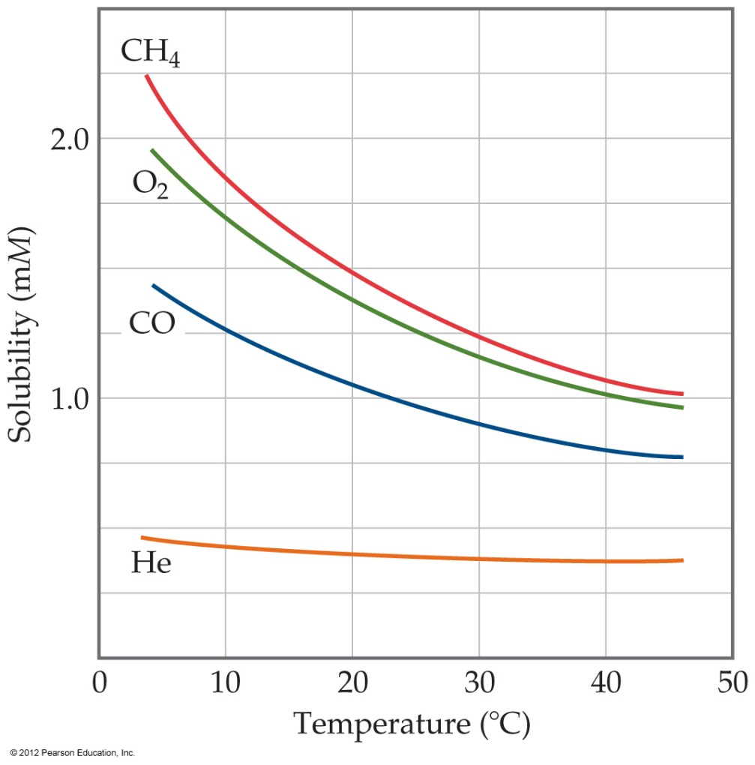
Temperature
The solubility of gases decreases with increasing temperature.
  Carbonated soft drinks are more “bubbly” if stored in the refrigerator.
  Warm lakes have less O₂ dissolved in them than cool lakes.
  Heated water becomes cloudy as bubbles of air form as solubility of gases in air decreases
© 2012 Pearson Education, Inc.

Slide 18
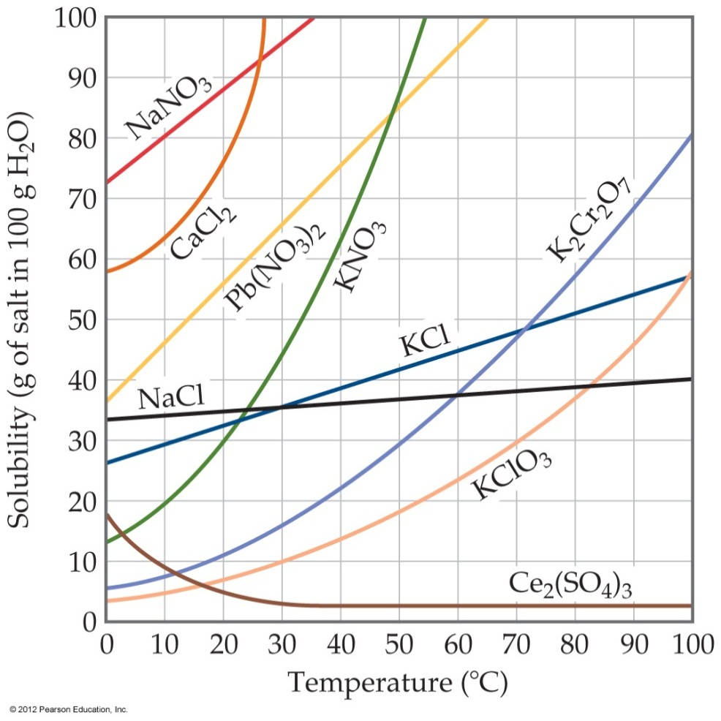
Temperature
Generally, the solubility of solid solutes in liquid solvents increases with increasing temperature.
© 2012 Pearson Education, Inc.

Slide 19
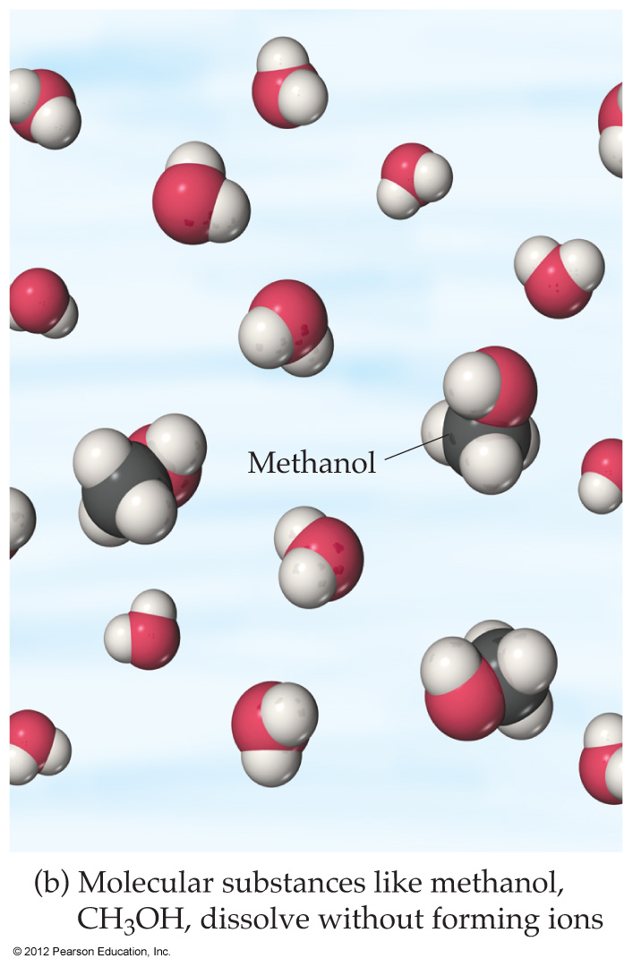
Behavior in Solution
An electrolyte is a substance that dissociates into ions when dissolved in water.
A nonelectrolyte may dissolve in water, but it does not dissociate into ions when it does so.

Slide 20
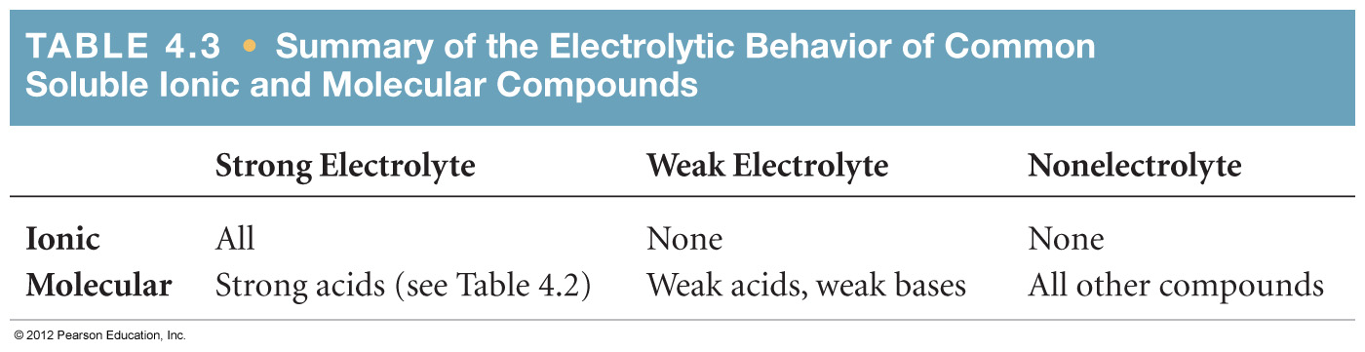
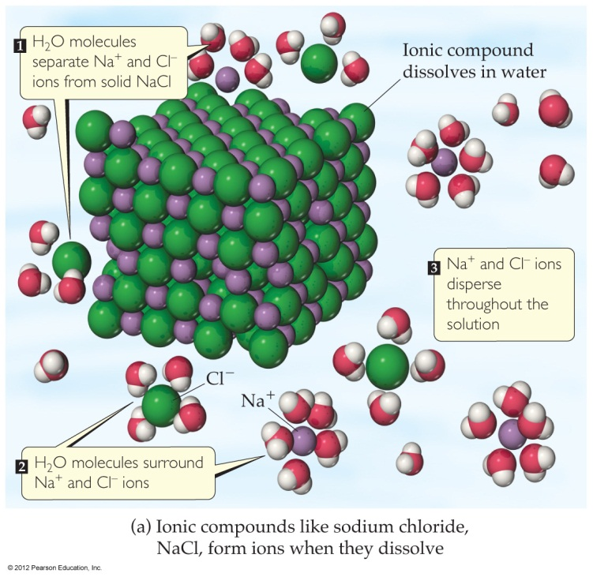
Electrolytes and Nonelectrolytes
Soluble ionic compounds tend to be electrolytes.

Slide 21

Electrolytes and Nonelectrolytes
Molecular compounds tend to be nonelectrolytes, except for acids and bases.

Slide 22
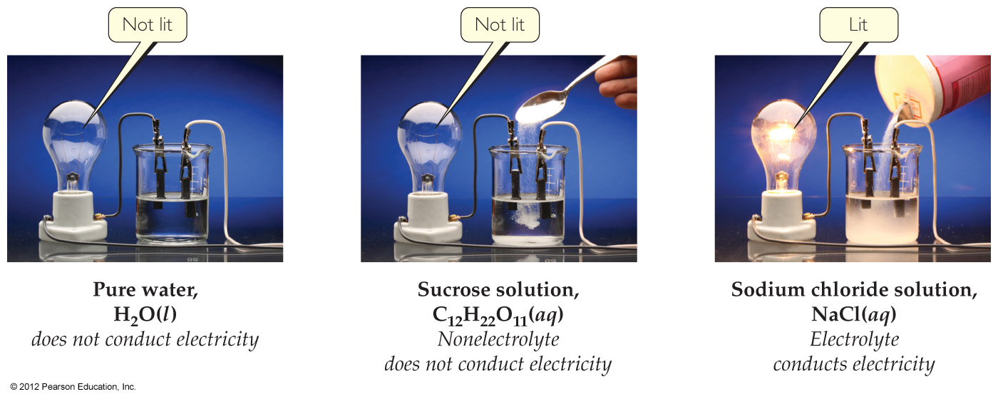
Electrolytes
A strong electrolyte dissociates completely when dissolved in water.
A weak electrolyte only dissociates partially when dissolved in water.

Slide 23
Acknowledgement
Add slides are from or adapted from the Instructors Resource CD to accompany Brown, LeMay, Bursten, Murphy, and Woodward, Chemistry:The Central Science, 12 th ed., Prentice Hall, 2012

