Slide 1
Kinetic-Molecular Theory
PS-21 November 8, 2013

Slide 2

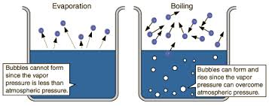
PS-21
Kinetic-Molecular Theory
PS-21 November 8, 2013

Slide 3
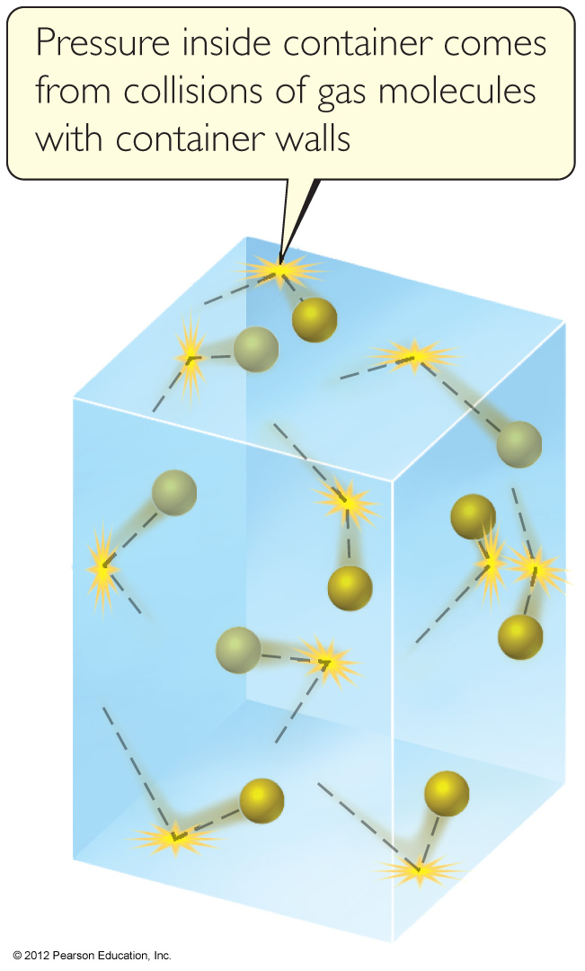
Kinetic-Molecular Theory
This is a model that aids in our understanding of what happens to gas particles as environmental conditions change.

Slide 4
Main Tenets of Kinetic-Molecular Theory
Gases consist of large numbers of molecules that are in continuous, random motion.

Slide 5
Main Tenets of Kinetic-Molecular Theory
The combined volume of all the molecules of the gas is negligible relative to the total volume in which the gas is contained.
About 0.1% of air is occupied by gas molecules

Slide 6
Main Tenets of Kinetic-Molecular Theory
Attractive and repulsive forces between gas molecules are negligible.

Slide 7
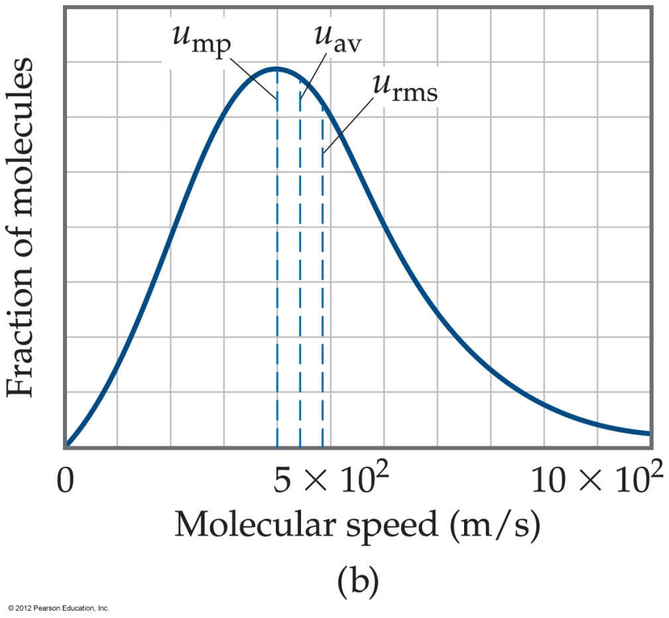
Main Tenets of Kinetic-Molecular Theory
Energy can be transferred between molecules during collisions, but the average kinetic energy of the molecules does not change with time, as long as the temperature of the gas remains constant.

Slide 8
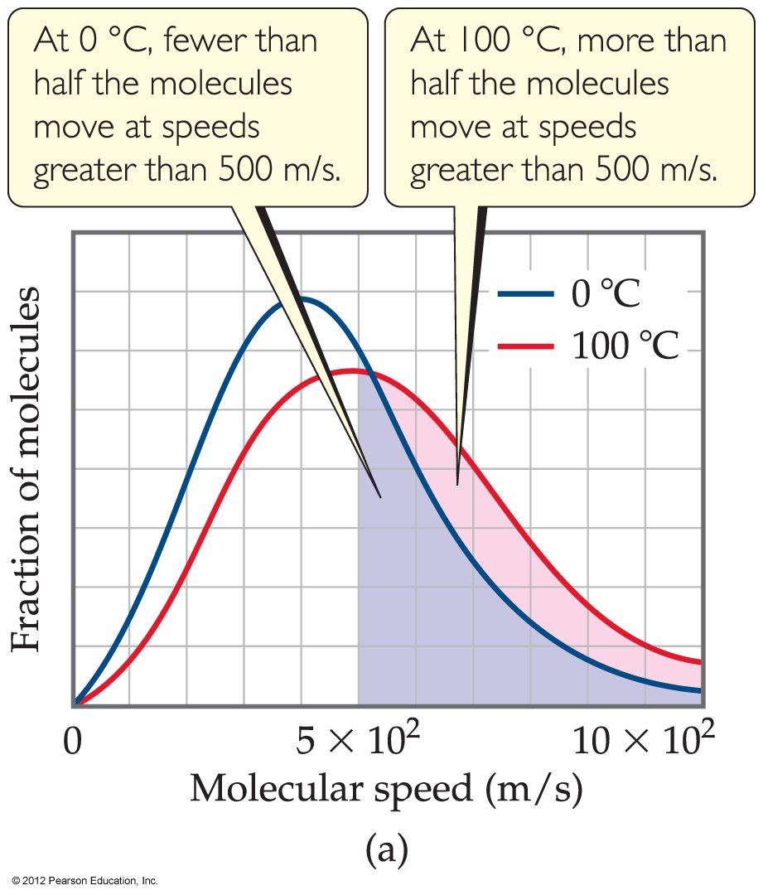
Main Tenets of Kinetic-Molecular Theory
The average kinetic energy of the molecules is proportional to the absolute temperature.

Slide 9
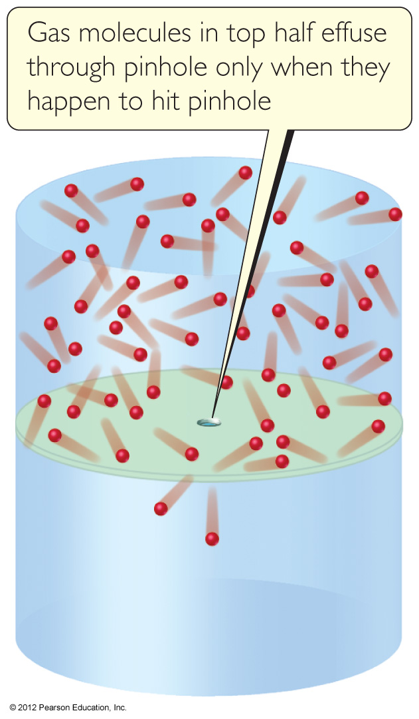
Effusion
Effusion is the escape of gas molecules through a tiny hole into an evacuated space.

Slide 10
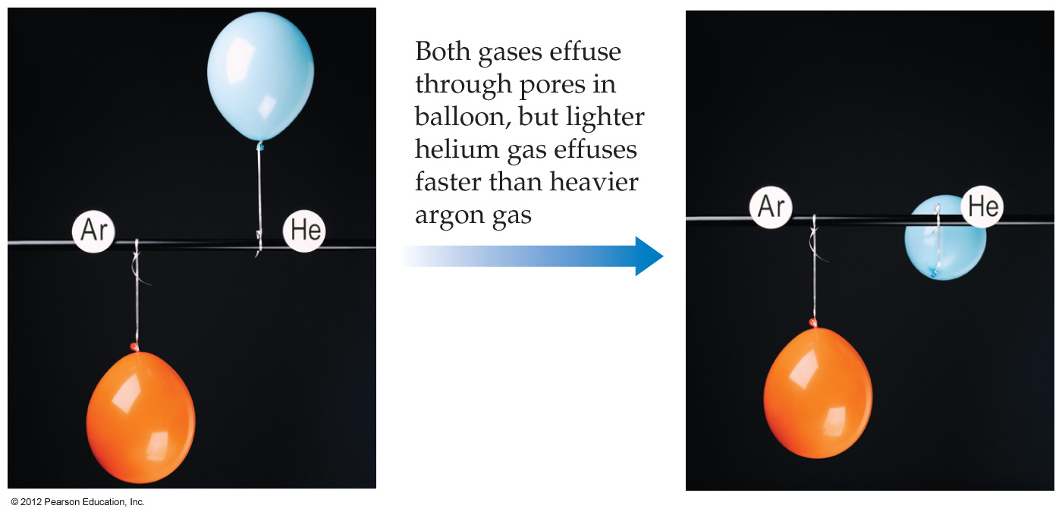
Effusion
The difference in the rates of effusion for helium and nitrogen, for example, explains why a helium balloon would deflate faster.

Slide 11
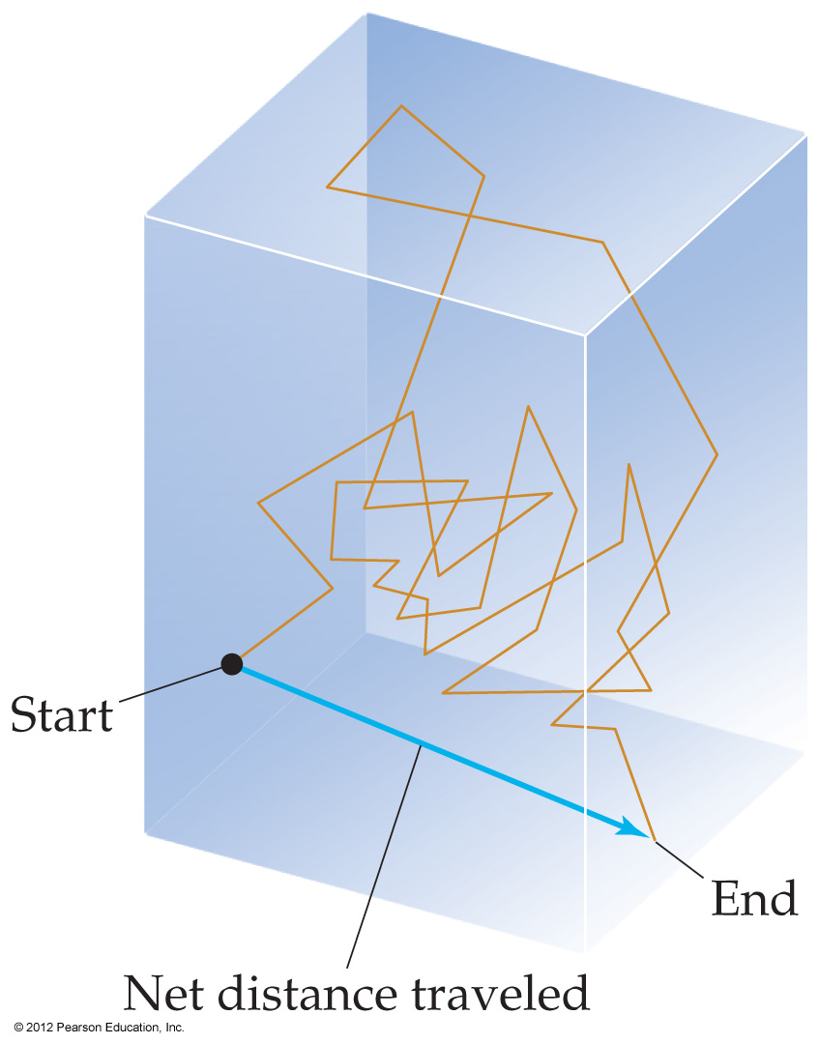
Diffusion
Diffusion is the spread of one substance throughout a space or throughout a second substance.

Slide 12
Graham's Law
KE₁
=
KE₂
1/2 m₁v₁²
=
1/2 m₂v₂²
m₁
v₂²
=
m₂
v₁²
√‾m₁
√‾v₂²
v₂
=
=
√‾m₂
√‾v₁²
v₁

Slide 13
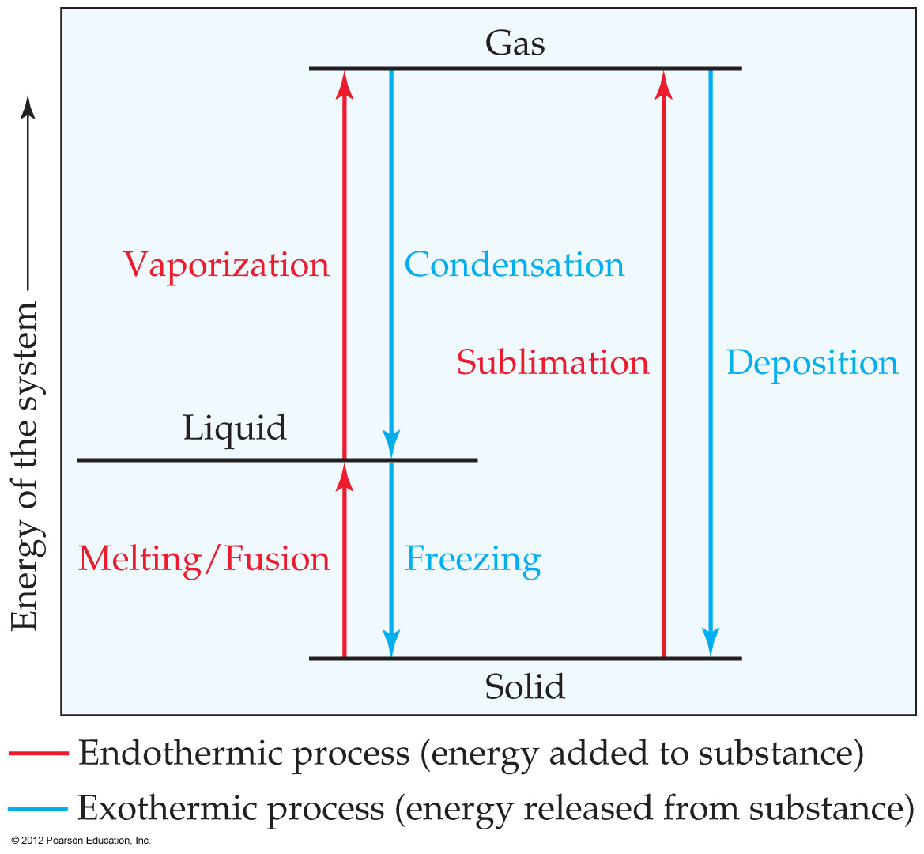
Phase Changes
Notes:
Start here 6/21/10

Slide 14
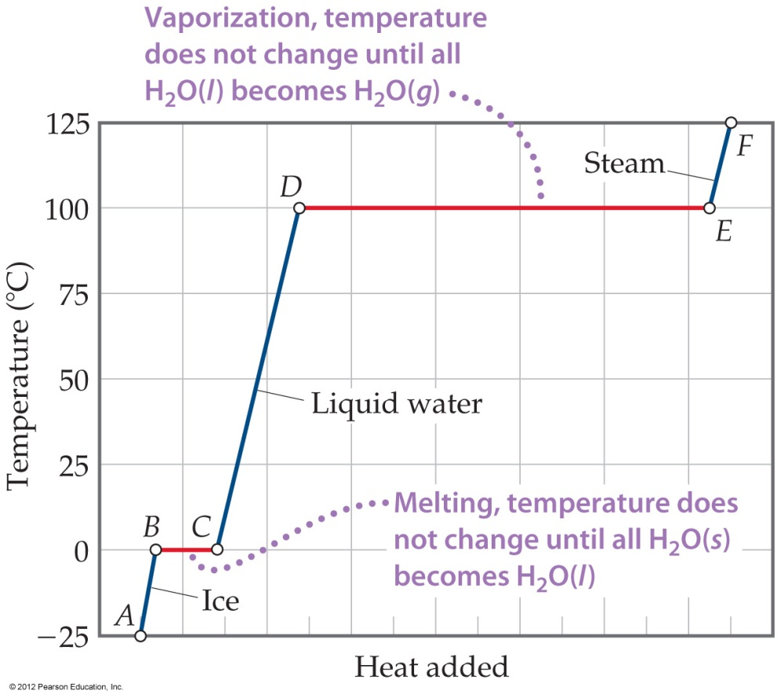
Energy Changes Associated with Changes of State
The heat added to the system at the melting and boiling points goes into pulling the molecules farther apart from each other.
The temperature of the substance does not rise during a phase change.

Slide 15
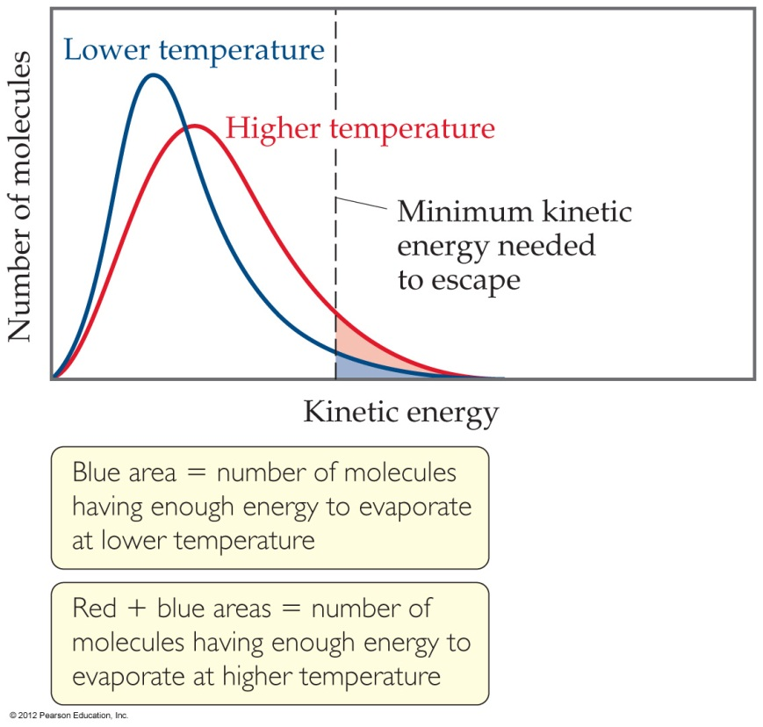
Vapor Pressure
At any temperature some molecules in a liquid have enough energy to break free.
As the temperature rises, the fraction of molecules that have enough energy to break free increases.

Slide 16
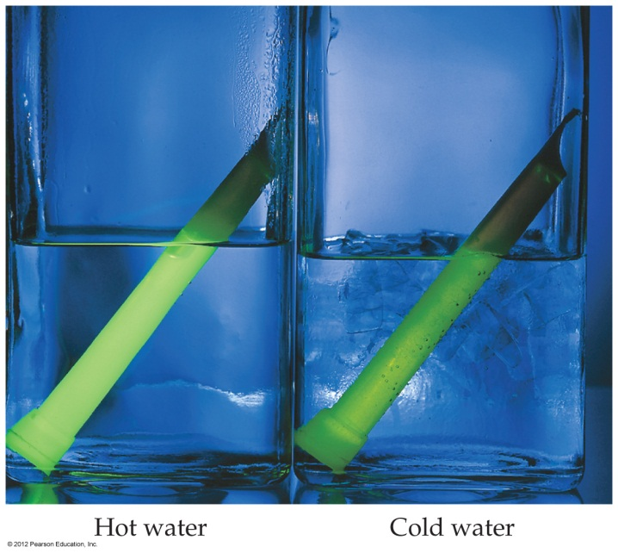
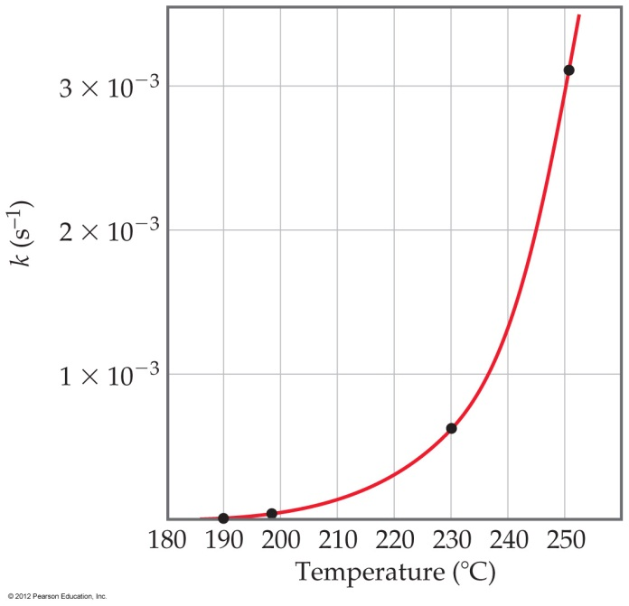
Temperature and Rate
Generally, as temperature increases, so does the reaction rate.
This is because the rate constant k is temperature-dependent.
Rate =
k[reactant]^{m}[reactant]^{n}
© 2012 Pearson Education, Inc.

Slide 17
Note the Glowsticks
The glowstick demonstration I did last PS-21 is a great way to present this idea.
Note: The Mountain Dew chemiliminescence demonstration is a hoax
  Glowstick in Mountain Dew bottle filled with water and detergent

Slide 18
The Collision Model
© 2012 Pearson Education, Inc.
In a chemical reaction, bonds are broken, and new bonds are formed.
Molecules can only react if they collide with each other.

Slide 19
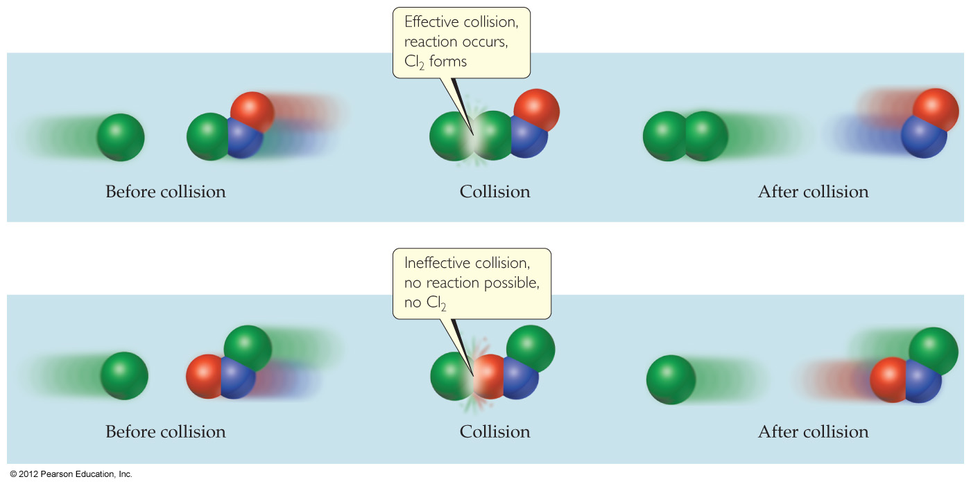
The Collision Model
Furthermore, molecules must collide with the correct orientation and with enough energy to cause bond breakage and formation.
© 2012 Pearson Education, Inc.

Slide 20
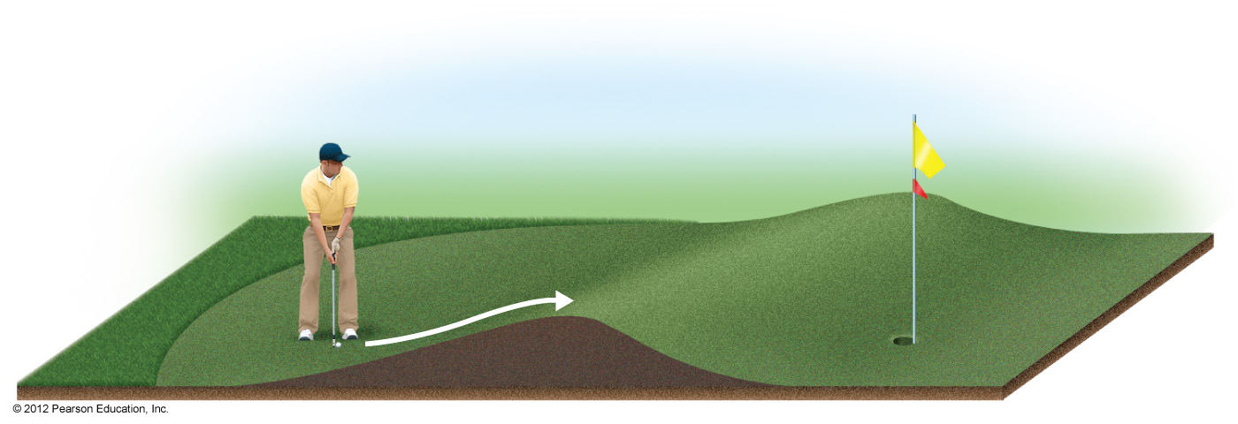
Activation Energy
In other words, there is a minimum amount of energy required for reaction: the activation energy, E_{a}.
Just as a ball cannot get over a hill if it does not roll up the hill with enough energy, a reaction cannot occur unless the molecules possess sufficient energy to get over the activation-energy barrier.
© 2012 Pearson Education, Inc.

Slide 21
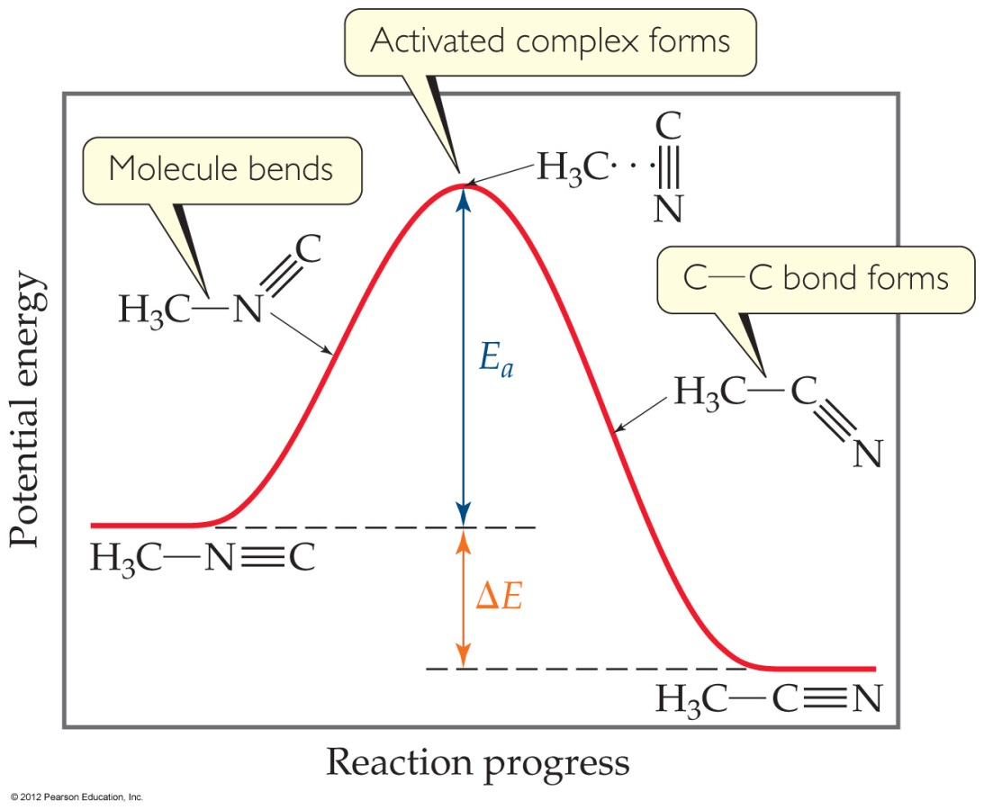
Reaction Coordinate Diagrams
It is helpful to visualize energy changes throughout a process on a reaction coordinate diagram like this one for the rearrangement of methyl isonitrile.
© 2012 Pearson Education, Inc.

Slide 22

Reaction Coordinate Diagrams
The diagram shows the energy of the reactants and products (and, therefore, ΔE).
The high point on the diagram is the transition state.
The species present at the transition state is called the activated complex.
The energy gap between the reactants and the activated complex is the activation-energy barrier.
© 2012 Pearson Education, Inc.

Slide 23
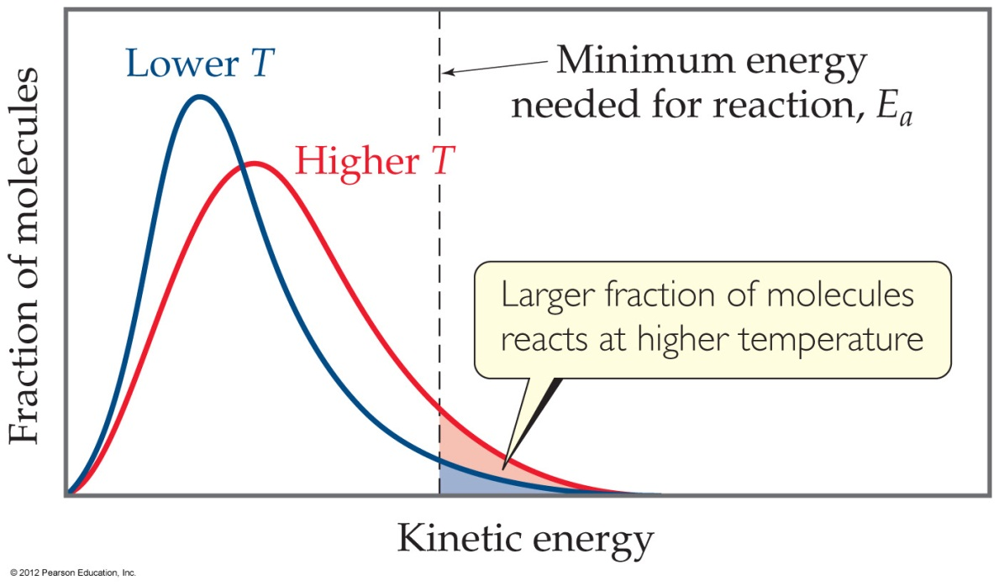
Maxwell–Boltzmann Distributions
Temperature is defined as a measure of the average kinetic energy of the molecules in a sample.
At any temperature there is a wide distribution of kinetic energies.
© 2012 Pearson Education, Inc.

Slide 24

Maxwell–Boltzmann Distributions
As the temperature increases, the curve flattens and broadens.
Thus, at higher temperatures, a larger population of molecules has higher energy.
© 2012 Pearson Education, Inc.

Slide 25

Maxwell–Boltzmann Distributions
If the dotted line represents the activation energy, then as the temperature increases, so does the fraction of molecules that can overcome the activation-energy barrier.
As a result, the reaction rate increases.
© 2012 Pearson Education, Inc.

Slide 26
Maxwell–Boltzmann Distributions
This fraction of molecules can be found through the expression
where R is the gas constant and T is the Kelvin temperature.
−E_{a}/RT
f = e
© 2012 Pearson Education, Inc.

Slide 27
Arrhenius Equation
Svante Arrhenius developed a mathematical relationship between k and E_{a}:
k = Ae
where A is the frequency factor, a number that represents the likelihood that collisions would occur with the proper orientation for reaction.
−E_{a}/RT
© 2012 Pearson Education, Inc.

Slide 28
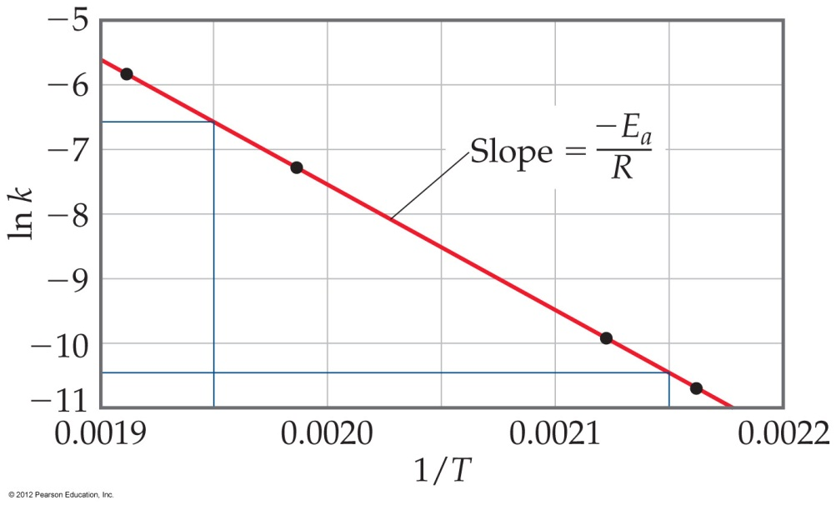
Arrhenius Equation
Taking the natural logarithm of both sides, the equation becomes
ln k = − ( ) + ln A
E_{a}
R
1
T
y = mx + b
Therefore, if k is determined experimentally at several temperatures, E_{a} can be calculated from the slope of a plot of ln k vs. .
1
T
© 2012 Pearson Education, Inc.
Notes:
Add problem(s) after this slide.

Slide 29
Chemically Related Demos for Physical Science Program
Looking for volunteers!!!

